Slide 1
Vehicle Telematics & GPS Analytics
Mega Project | July 2026

Slide 2
Vehicle Telematics & GPS Analytics
Agenda
AGENDA
Project Overview Dataset Tech Stack & Python Concepts Used Output Report / Dashboard Summary Future Scope

Slide 3

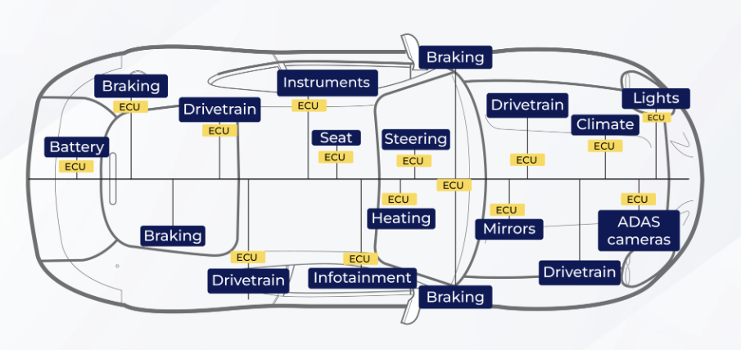
1. Project Overview
1.1 What is Vehicle Telematics & GPS Analytics?
A real-time system that simulates, transmits, stores, and visualizes vehicle telemetry data using cloud and dashboard technologies
Combines GPS location tracking with vehicle health parameters — speed, fuel level, engine temperature — for continuous live monitoring
Built for real-world use cases such as fleet management, driver behavior monitoring, and vehicle safety analytics
Bosch ECU
1.2 System Architecture & Data Flow
Telemetry Generator simulates GPS, speed, fuel, and engine data for a virtual vehicle trip
Firebase Firestore stores each telemetry record in real time as the trip progresses
Streamlit Dashboard reads live data and renders KPIs, charts, maps, and alerts
Analytics modules (Trip, Speed, Fuel, Engine, Driving Behavior) process the data to generate insights and trigger alerts.
Distributed Vehicle Electronics Architecture
Vehicle Telematics & GPS Analytics | Group Project Presentation
3

Slide 4
2. Dataset
2.1 Dataset Description
Synthetic dataset generated in real time by a custom Telemetry Generator — no static CSV file used
Each record captures: Timestamp, Latitude, Longitude, Speed (km/h), Fuel Level (%), Engine Temperature (°C)
A trip runs for 20–30 sequential records, modelling real driving phases — acceleration, cruising, deceleration
Fuel level decreases gradually while engine temperature reacts realistically to the current speed
Data is streamed to Firebase Fire store under vehicles/{vehicle_id}/telemetry, refreshing every 10 seconds
Data Set-1 :- https://shorturl.at/FLLVz
Data Set-2 :- https://shorturl.at/SDBpu
Git Link :- sudharsana172002/Megaproject
Vehicle Telematics & GPS Analytics | Group Project Presentation
4

Slide 5
3. Tech Stack & Python Concepts Used
Technology | Purpose
Python | Core language for simulation, analytics, and backend logic
Streamlit | Builds the real-time interactive dashboard
Firebase | Stores live telemetry data in real time
Pandas | Handles and processes data using DataFrames
Plotly Express | Creates interactive charts for speed, fuel, engine, and driving behavior trends
Folium | Renders the live GPS route on an interactive map
streamlit-folium | Embeds the Folium map inside the dashboard
OSRM API | Generates real road-route paths between coordinates
requests | Fetches routing data from the OSRM API
streamlit-autorefresh | Auto-refreshes the dashboard every 10 seconds
Object-Oriented Programming — dedicated classes for the Telemetry Generator, Firebase Service/Reader, and every Analysis/Dashboard module
Modular Package Design — code organized into simulator, firebase, analytics, dashboard, and services packages
Encapsulation & Single Responsibility — each class handles exactly one job, e.g., Speed Analysis, Fuel Analysis, Engine Analysis
Random Module — random.uniform() and random.randint() generate realistic telemetry values
Math Module — Haversine formula (radians, sin, cos, atan2) calculates GPS distance between coordinates
Pandas Operations — Data Frame sorting, iloc, mean/max/min aggregation, and column renaming
REST API Integration — the requests library fetches live road routes from OSRM
Vehicle Telematics & GPS Analytics | Group Project Presentation
5

Slide 6
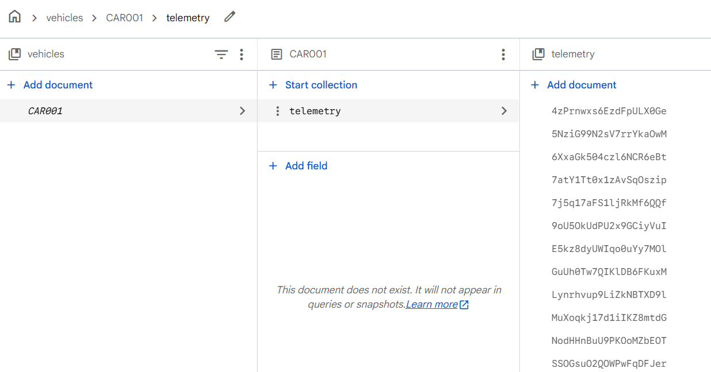
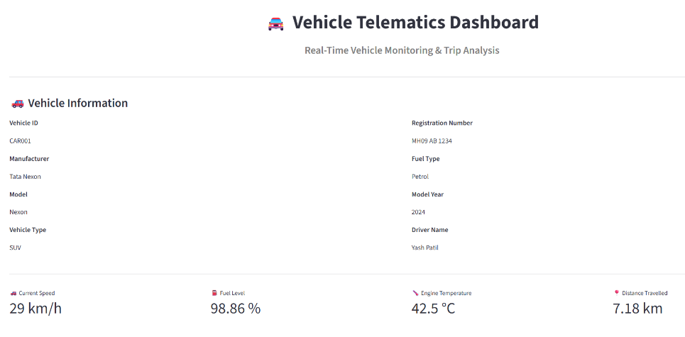
4. Output Report
4.1 Dashboard Overview
Vehicle Information panel — Vehicle ID, Manufacturer, Model, Registration Number, Driver Name
Live KPI cards — Current Speed, Fuel Level, Engine Temperature, Distance Travelled
Trip Summary — Average & Maximum Speed, Fuel Consumed, Trip Duration
Driving Behavior Summary — Normal / Harsh Acceleration / Harsh Braking / Overspeed counts with a donut chart
Vehicle Alerts — Overspeed and high engine temperature warnings
Emergency SOS button — simulated emergency alert trigger
Dashboard auto-refreshes every 10 seconds for real-time monitoring
Vehicle Telematics & GPS Analytics | Group Project Presentation
6

Slide 7
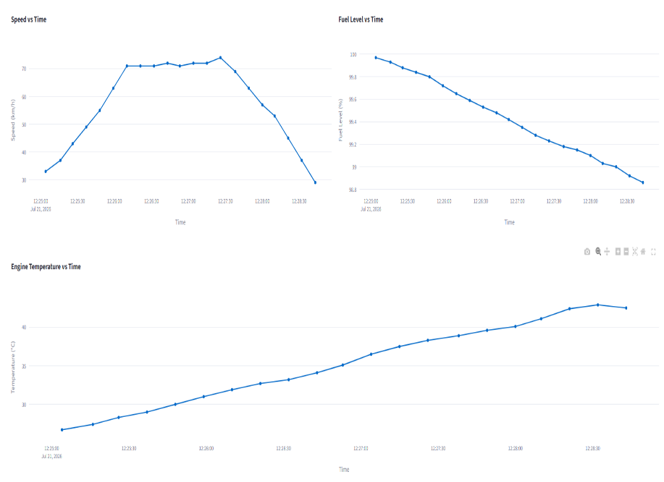
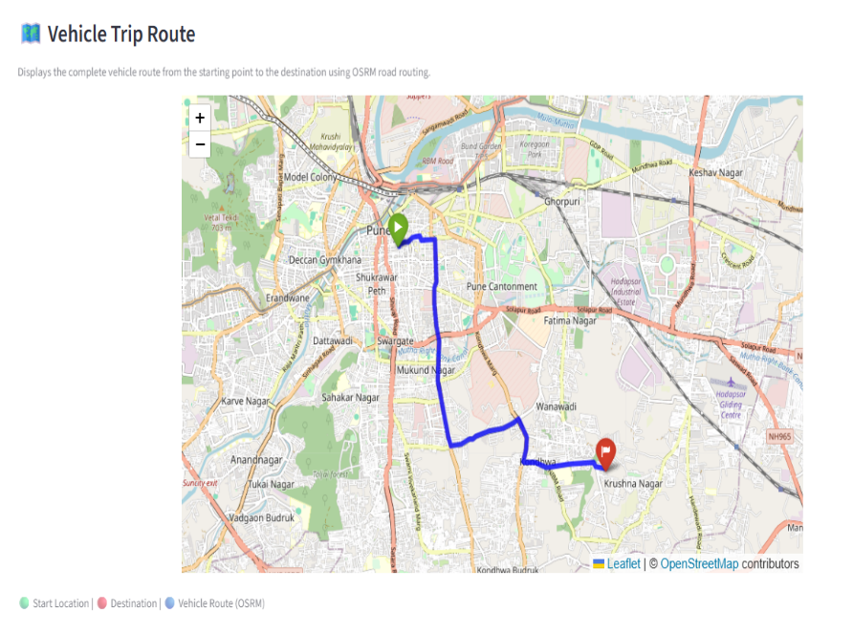
4. Output Report / Dashboard
4.2 Live Monitoring View
Displays real-time KPIs, speed/fuel/engine trend charts, and the GPS route map
Screenshot below shows the dashboard in action during a live simulated trip
Vehicle Telematics & GPS Analytics | Group Project Presentation
7

Slide 8
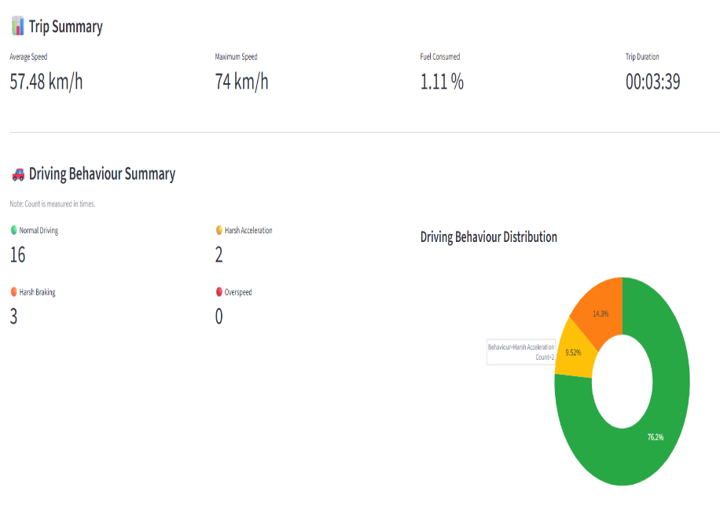
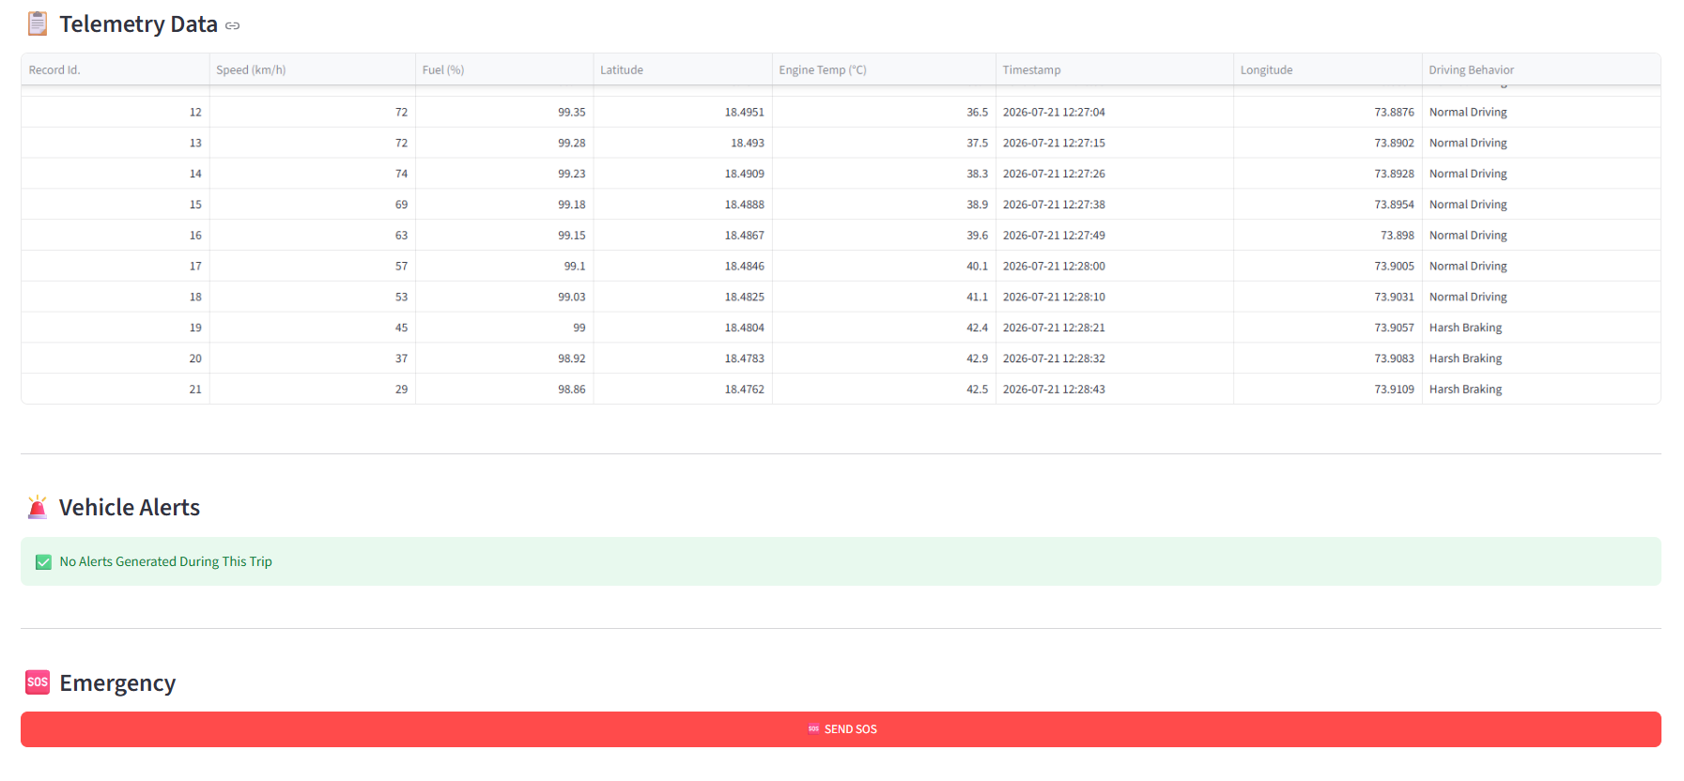
4. Output Report / Dashboard
4.3 Trip Data, Alerts & SOS
Telemetry data table, driving-behaviour tags, vehicle alerts, and the Emergency SOS panel
Vehicle Telematics & GPS Analytics | Group Project Presentation
8

Slide 9
5. Summary & Future scope
5.1 Project Summary
Built a complete, end-to-end vehicle telematics pipeline — Simulation → Cloud Storage → Real-time Analytics → Visualization
Demonstrates practical integration of cloud databases, geospatial mapping, and interactive data visualization using Python
Provides actionable insights into driving behavior, vehicle health, and trip performance
Applicable to fleet management, insurance telematics, and driver safety monitoring
5.2 FUTURE SCOPE
Integrate real GPS/OBD-II hardware for live data instead of simulation
Add Machine Learning-based driver risk scoring and predictive engine-fault detection
Build a multi-vehicle fleet dashboard for organization-wide monitoring
Enable historical trip analytics and trip-to-trip comparison
Develop a mobile app with push notifications for real-time alerts
Add geofencing and theft detection with automated emergency-service integration
Vehicle Telematics & GPS Analytics | Group Project Presentation
9

Slide 10
THANK YOU

